Slide 1
Unit 16: Do you have any pets?
Lesson 1

Slide 2
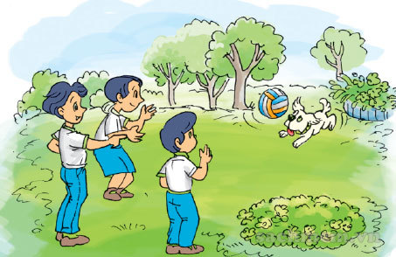
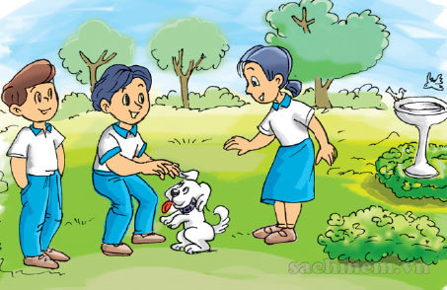
Activity 1: Look, listen and repeat
Who are they in picture a + picture b?
There are two pictures.
How many pictures are there?
They are Quan, Nam and Mai.

Slide 3
That’s my dog.
Do you have any pets?
Wow! He’s cute!
Yes, I do. I have two dogs.

Slide 4
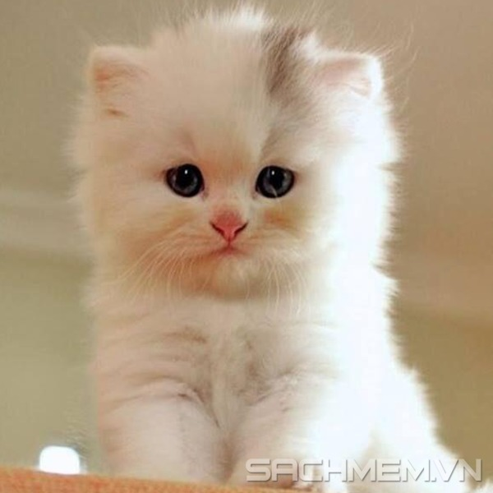
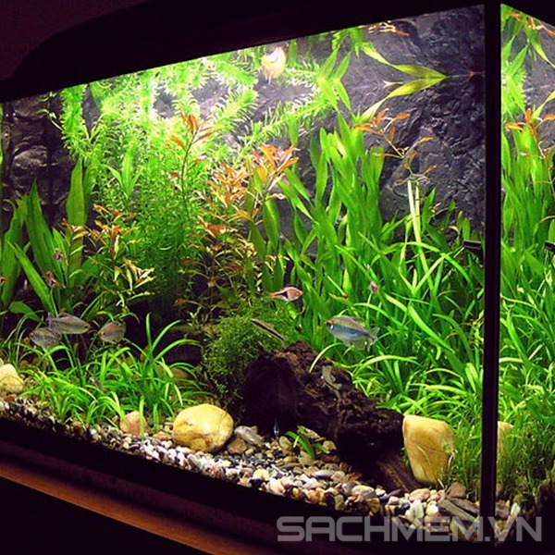
Activity 2: Point and say
a) Vocabulary
cat
dog
fish tank

Slide 5
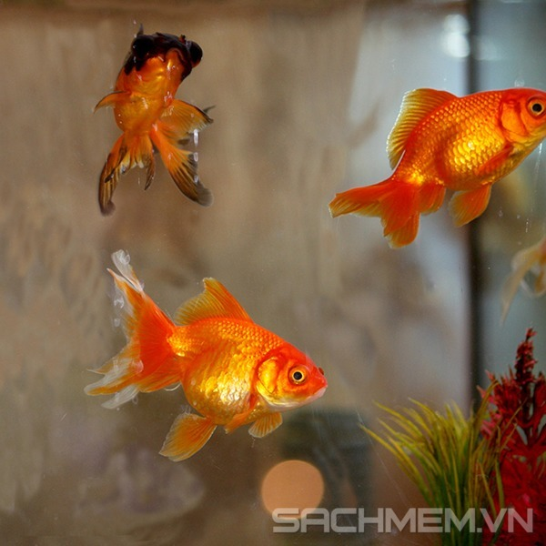
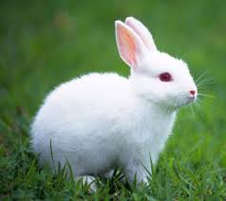
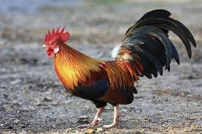
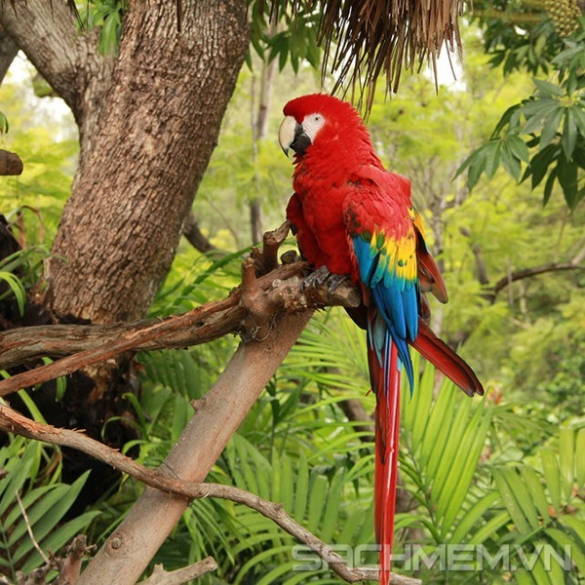
goldfish
in front of
next to
parrot
rabbit

Slide 6
b) Sentences
* Hỏi người khác xem có con vật nào hay không?
A: Do you have any pets?
B: Yes, I do./ No, I don’t
* Note: a goldfish → two goldfish

Slide 7
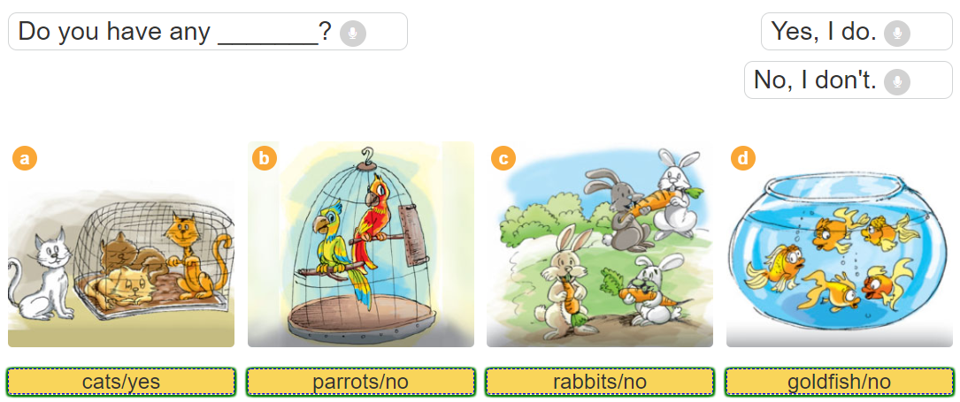

Slide 8
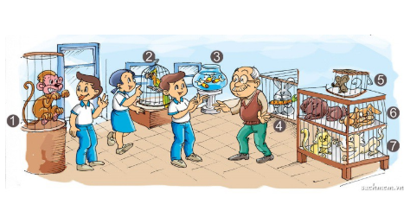
Activity 3: Let’s talk
Do you have any _______?
Yes, I do., No, I don’t.

Slide 9
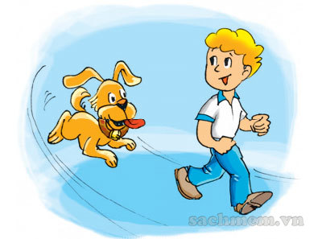
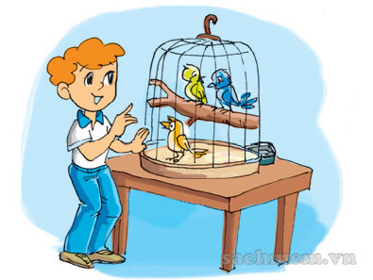
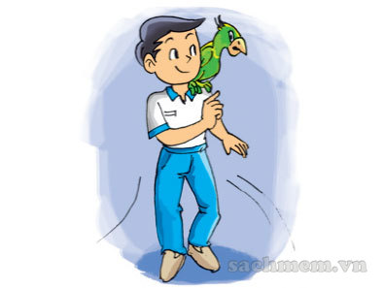
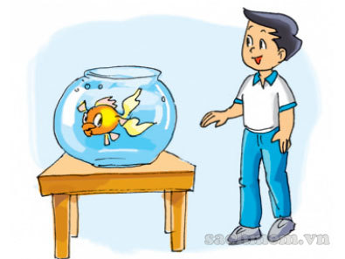
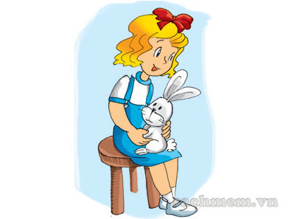
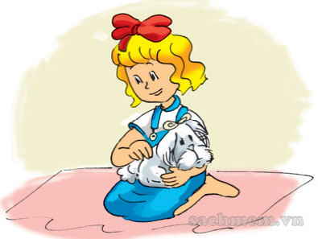
Activity 4: Listen and tick
1
a
b
2
a
b
3
a
b

Slide 10
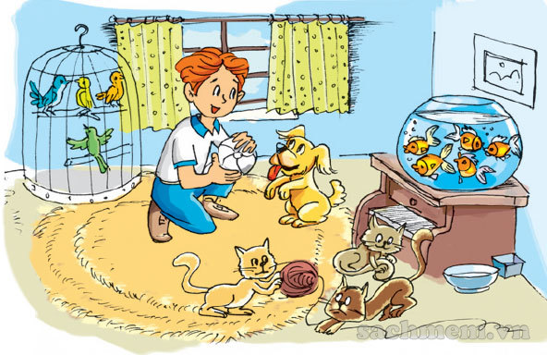
Activity 5: Look and write
I have a lot of pets. I have one (1)_____ and three (2)____ . I have four (3)_____ in the cage and five (4)______ in the fish tank. Do you have a pet?
dog
cats
birds
goldfish

Slide 11
Activity 6: Let’s write
* What pets do you have?_________________________________
* Where are your pets? __________________________________
Example:
* What pets do you have?_________________________________
* Where are your pets? __________________________________
I have nine cats, three dogs and a fish.
They’re in the cage.

